Slide 1
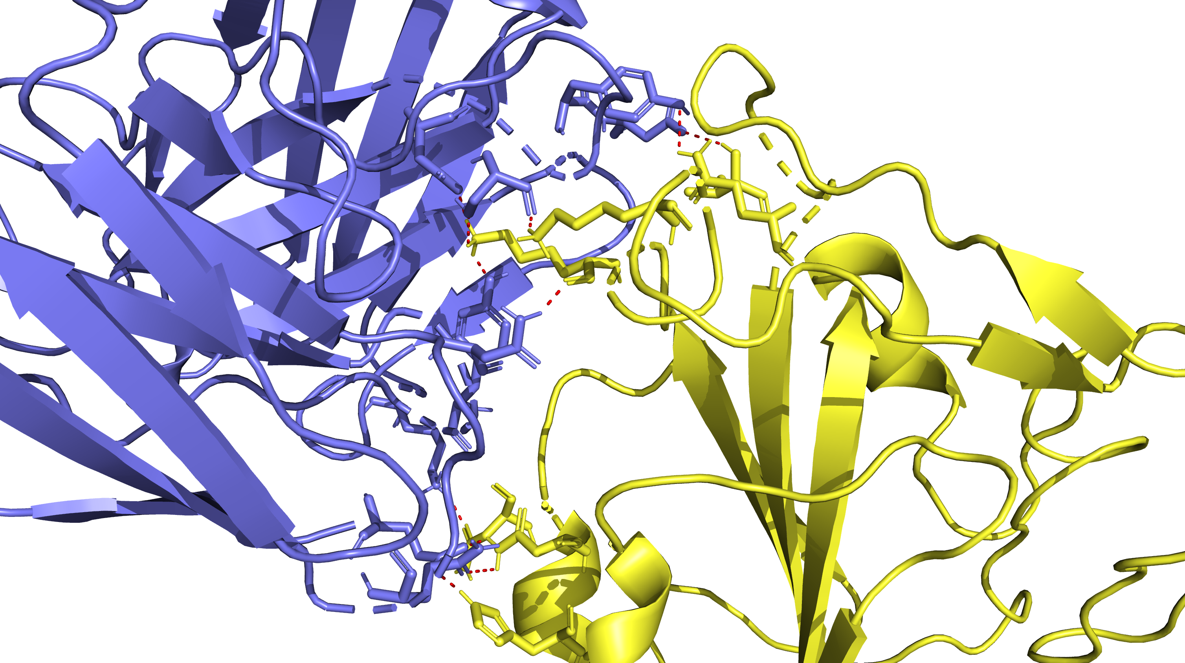
XBB.1.5 in Complex with 7x2h
V503
K444
Q506
K440
N370
N343
H339

Slide 2
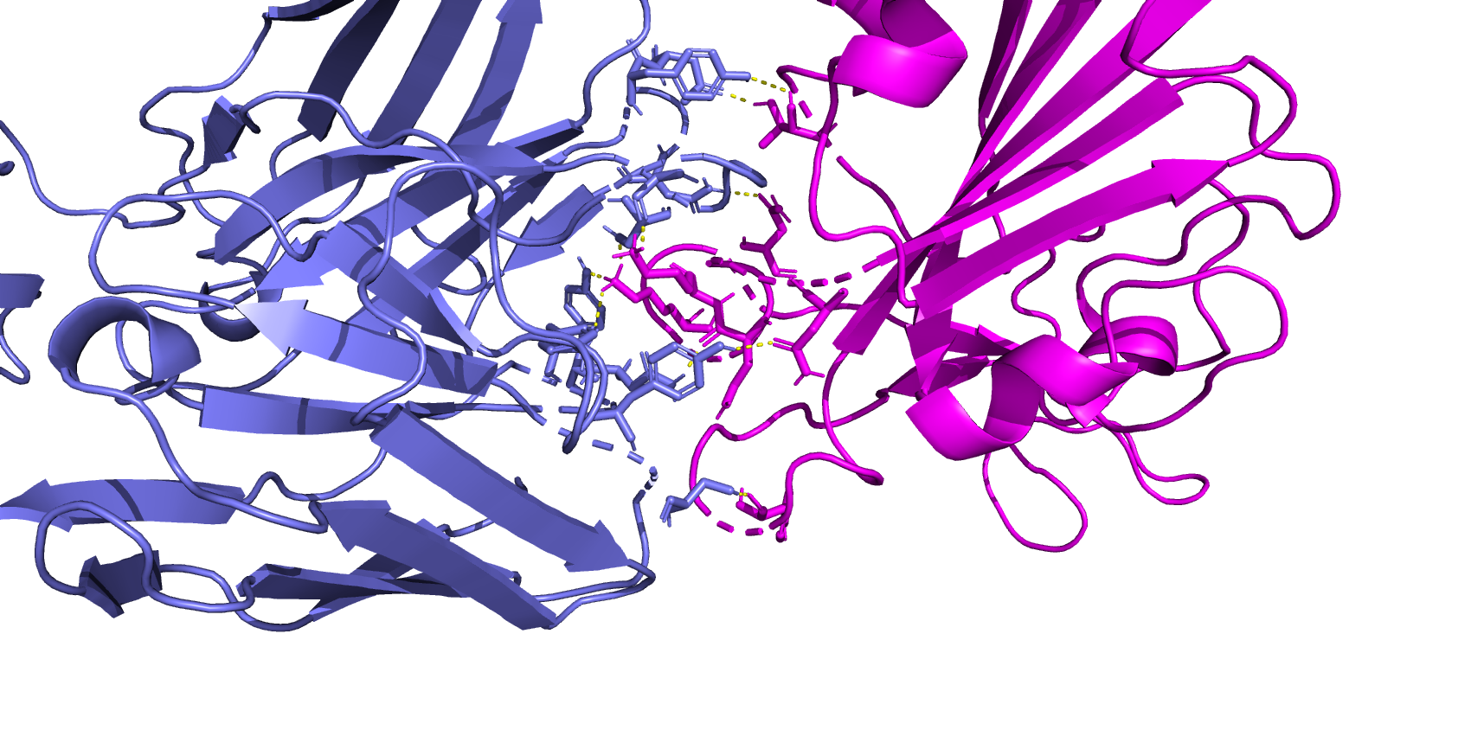
AB 7x2h complexed with BA.2.86
T345
N447
K439
K443
N436
N438

Slide 3
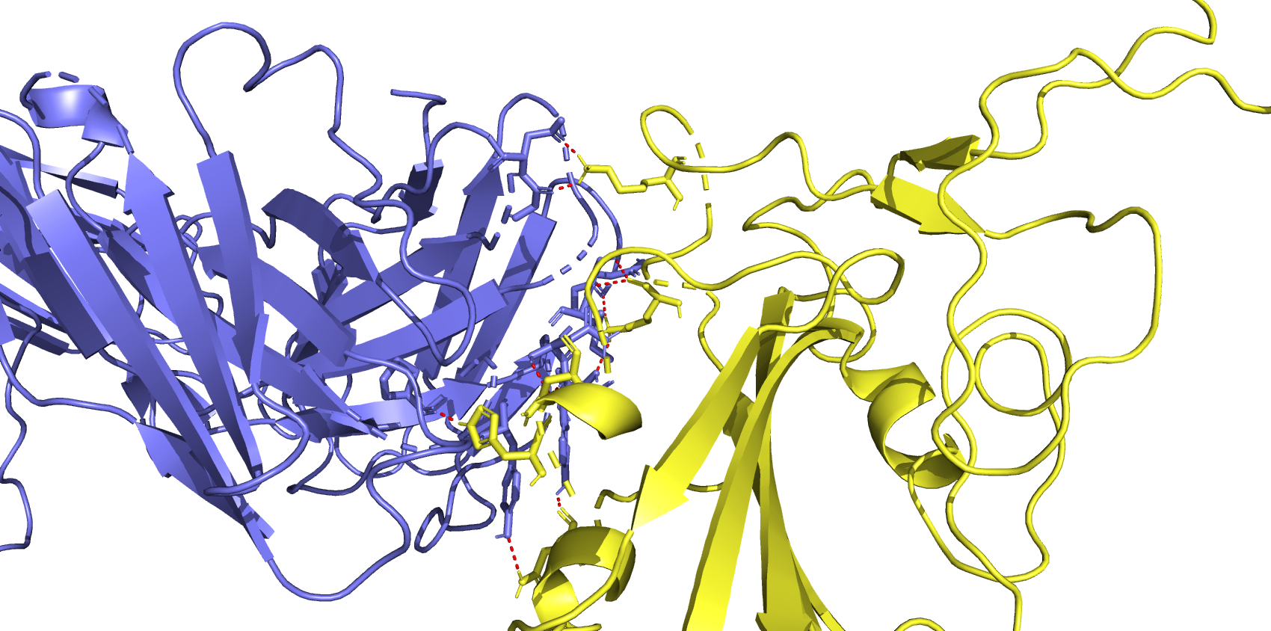
AB 8DW9 complexed with XBB.1.5
K444
K440
N343
H339
N370

Slide 4
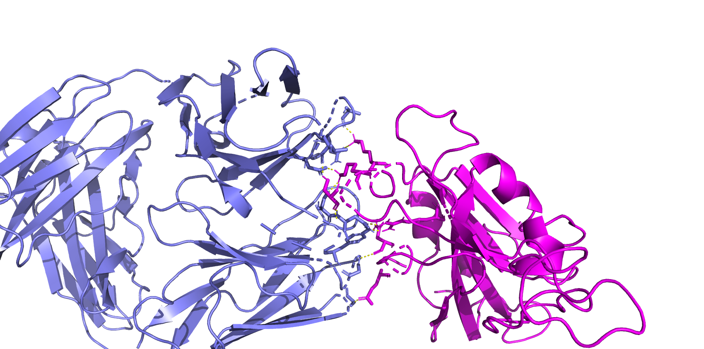
BA286 complex w 8DW9 AB
K439
K443
S445
R506
N343

Slide 5
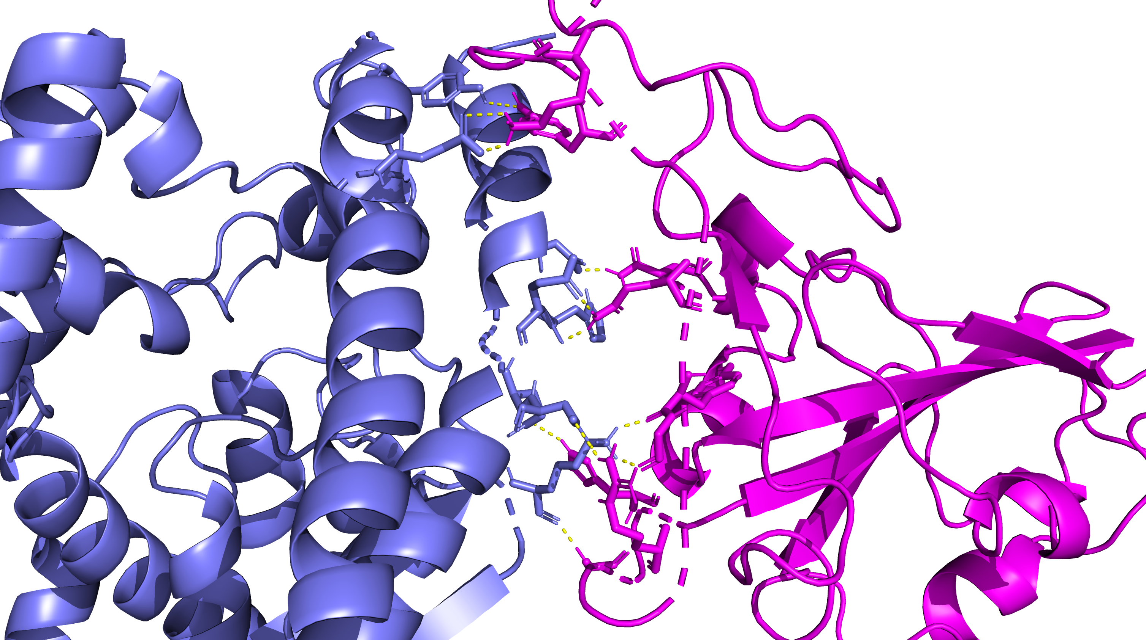
6M0J ACE2 Complexed with BA.2.86
Y486
K481
N416
N490
H502
Y492
R492
G499

Slide 6
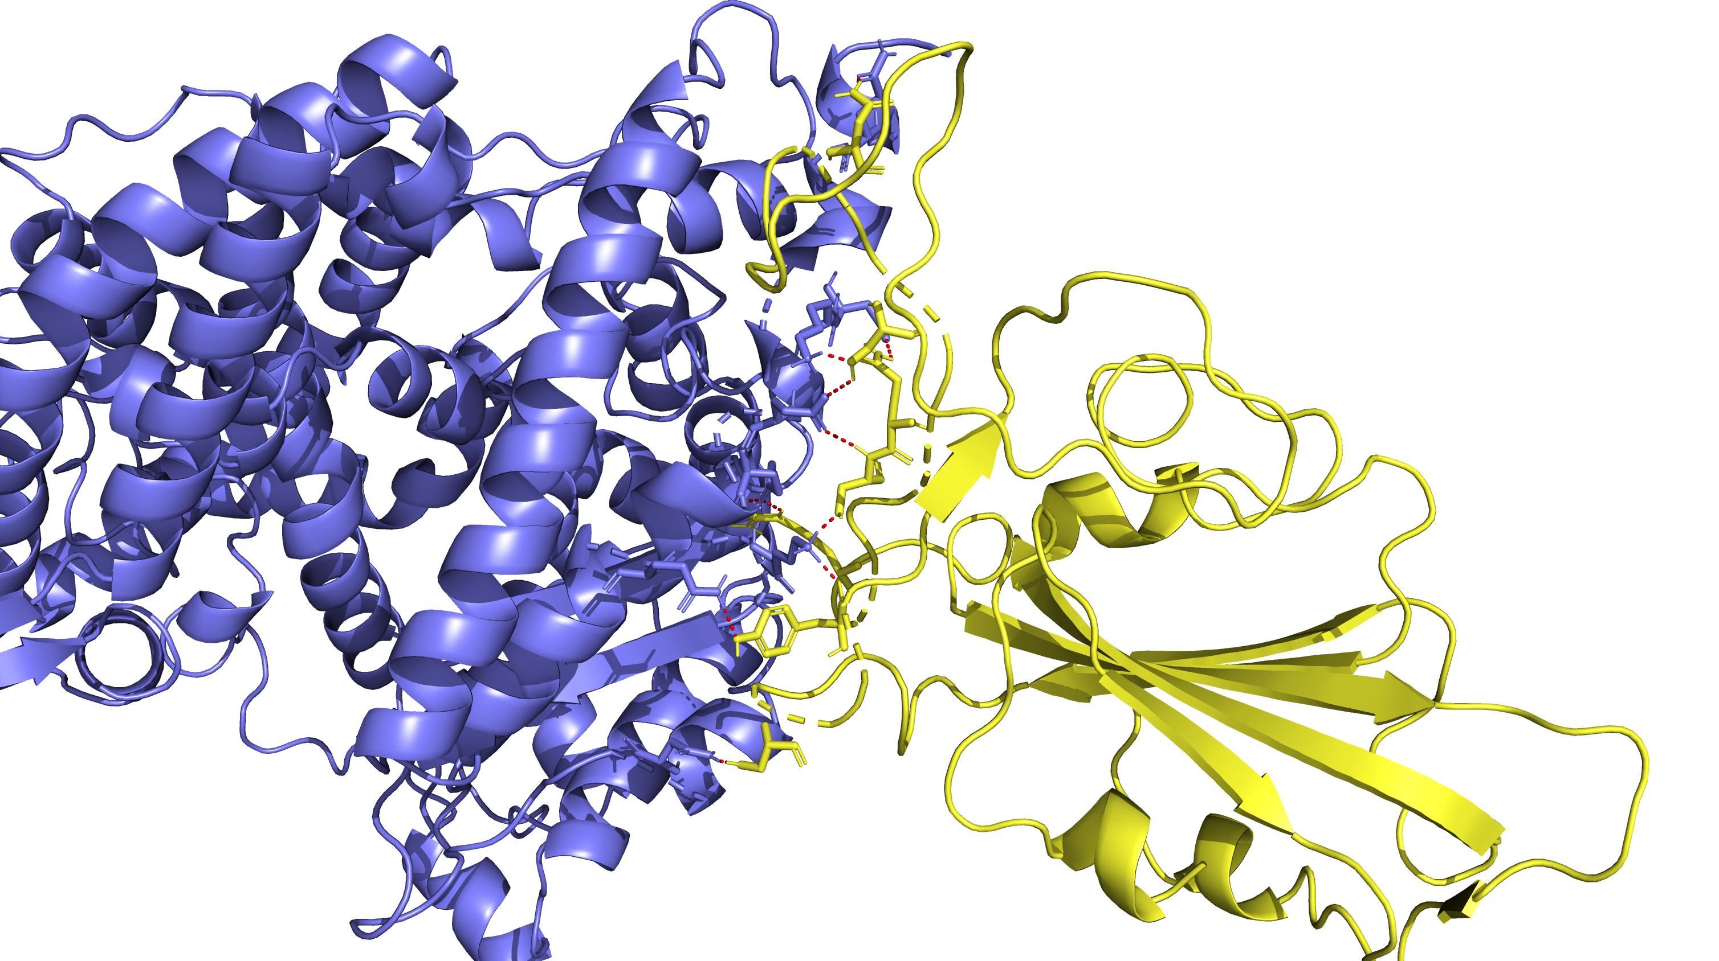
XBB15 Complexed with 6M0J ACE2
N487
Q493
S490
S494
R498
Y449
S446

Slide 7
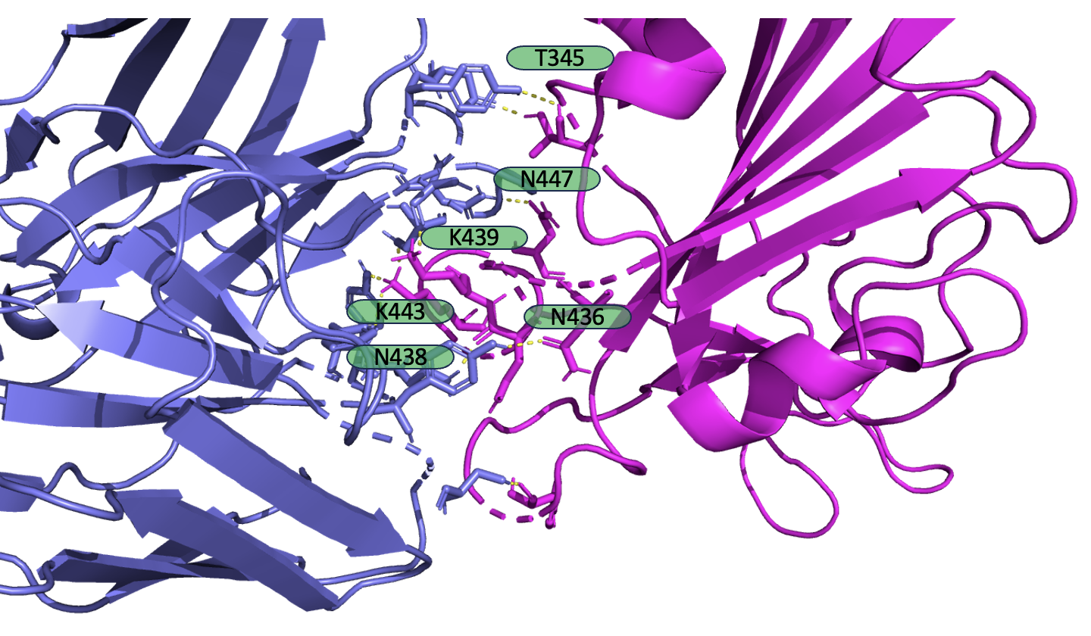
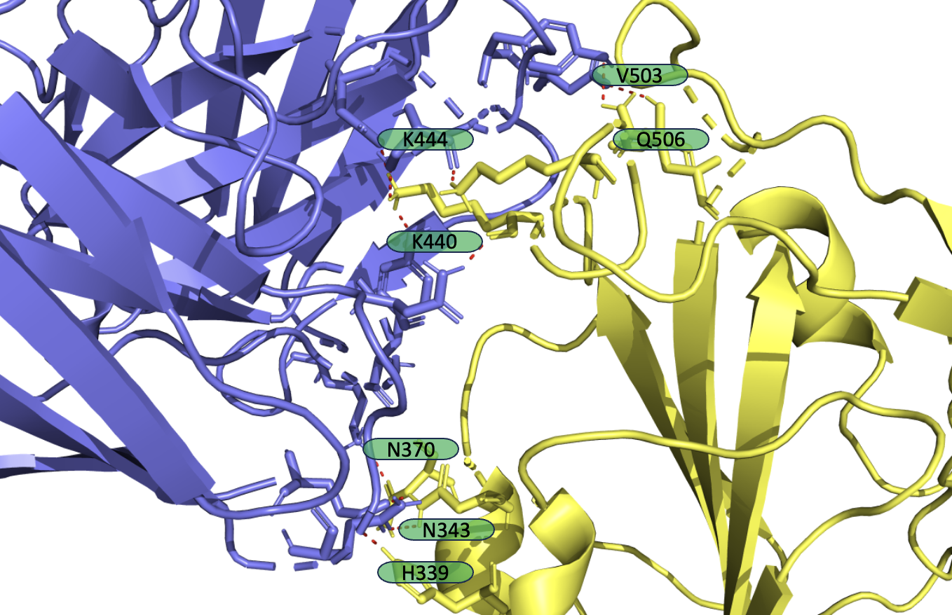
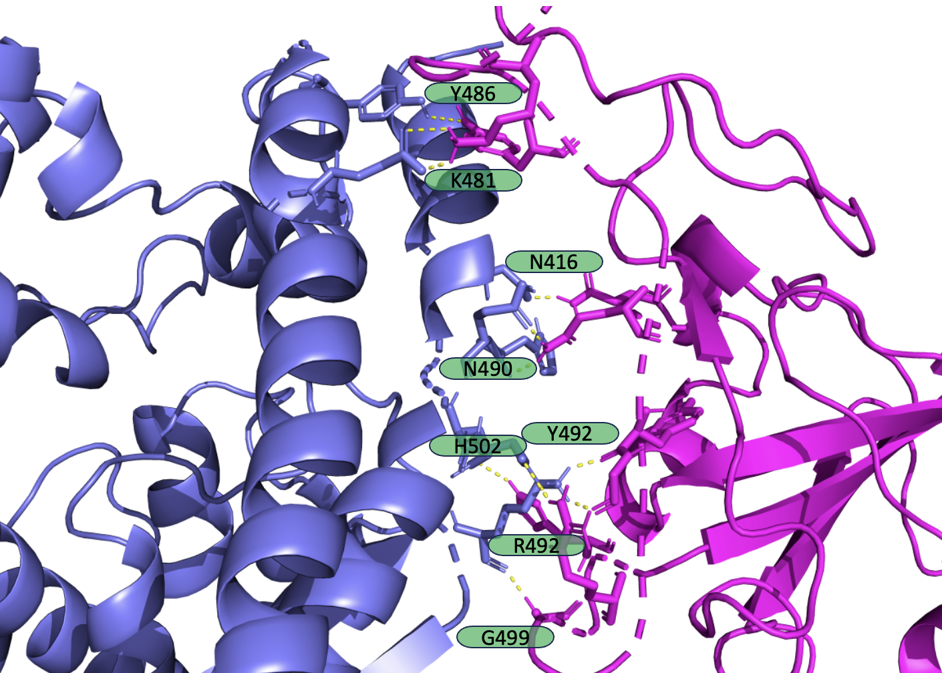
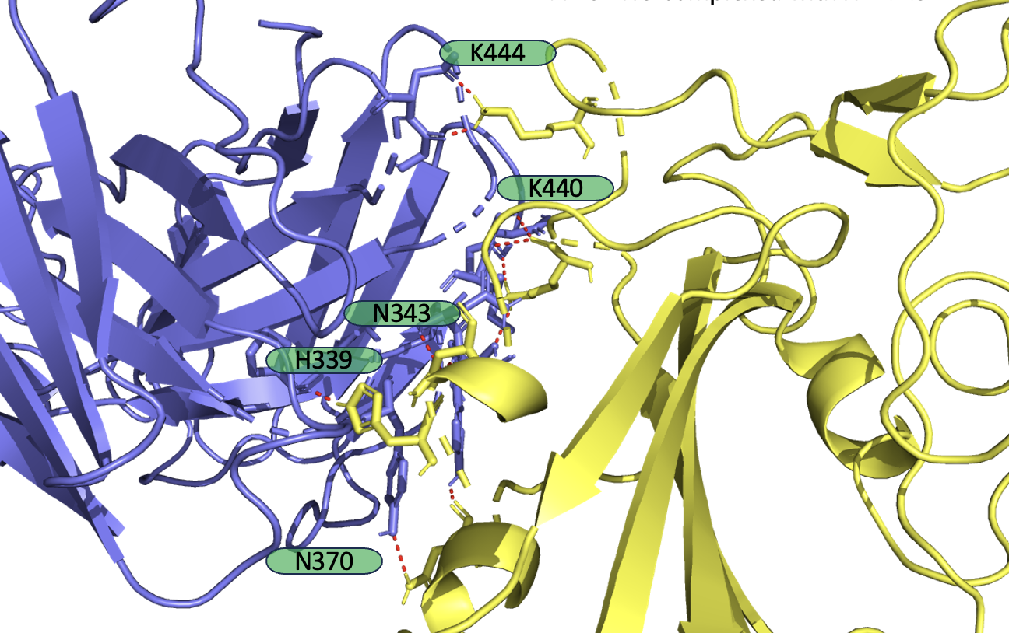
Antibody Analysis 2x2 table
(A)
(B)
(C)
(D)

